Slide 1
Prediction of End-tidal Sevoflurane Gas Concentration of Patient During Surgery
Damian Dziedzic
Domenico panuccio
Ee-uy 4563
Intro to machine learning

Slide 2
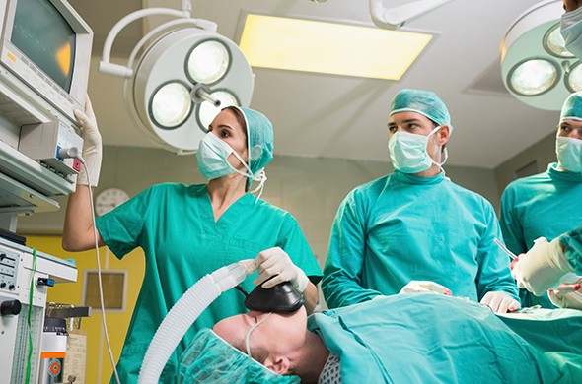

Project Details
In this project the current time (t) exhaled sevoflurane gas concentration is predicted based on features from the previous second (t-1) using the models:
Multivariate Time Series Forecasting with Long Short-Term Memory (LSTM) Recurrent Neural Network
Regular Multivariate Linear Regression
Features
Heart Rate (bpm)
Blood Oxygen Saturation (%)
Mean Blood Pressure (mm Hg)
End-tidal CO2 (mm Hg)
Respiratory Rate (breaths per minute)
Inspired oxygen concentration (%)
Inspired sevoflurane gas concentration (%)
End-tidal sevoflurane gas concentration (%)
LSTM Recurrent Neural Network Block Diagram

Slide 3
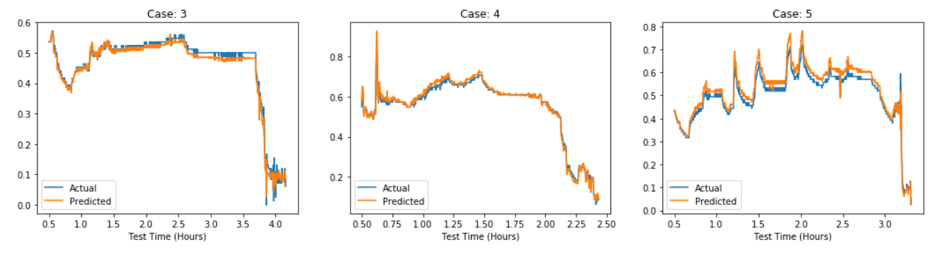
Project Results – LSTM RNN
R² Values for the following surgical cases:
Case 3: 0.986
Case 4: 0.990
Case 5: 0.930
Not very consistent. Perhaps the LSTM model was too complex for the dataset and when there was noise or large variance in the data it was more difficult to track

Slide 4
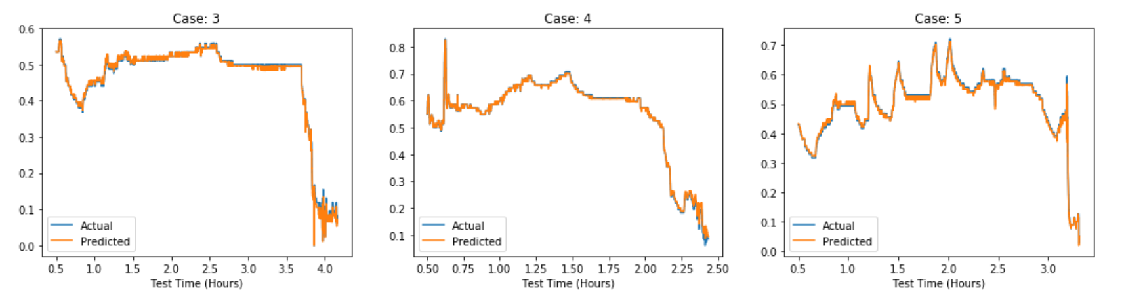
Project Results – Linear regression
R² Values for the following surgical cases:
Case 3: 0.997
Case 4: 0.998
Case 5: 0.996
Linear regression demonstrates improved performance compared to the LSTM recurrent neural network

